Slide 1
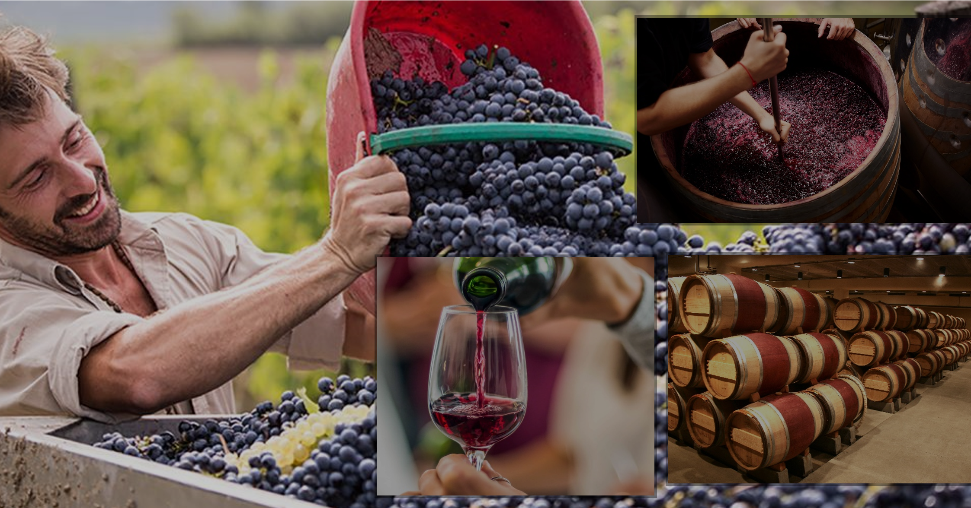
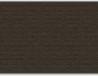
Red wine’s physicochemical characteristics & it’s quality
Impact of red wine’s physicochemical characteristics on its quality
Notes:
It is a note.

Slide 2

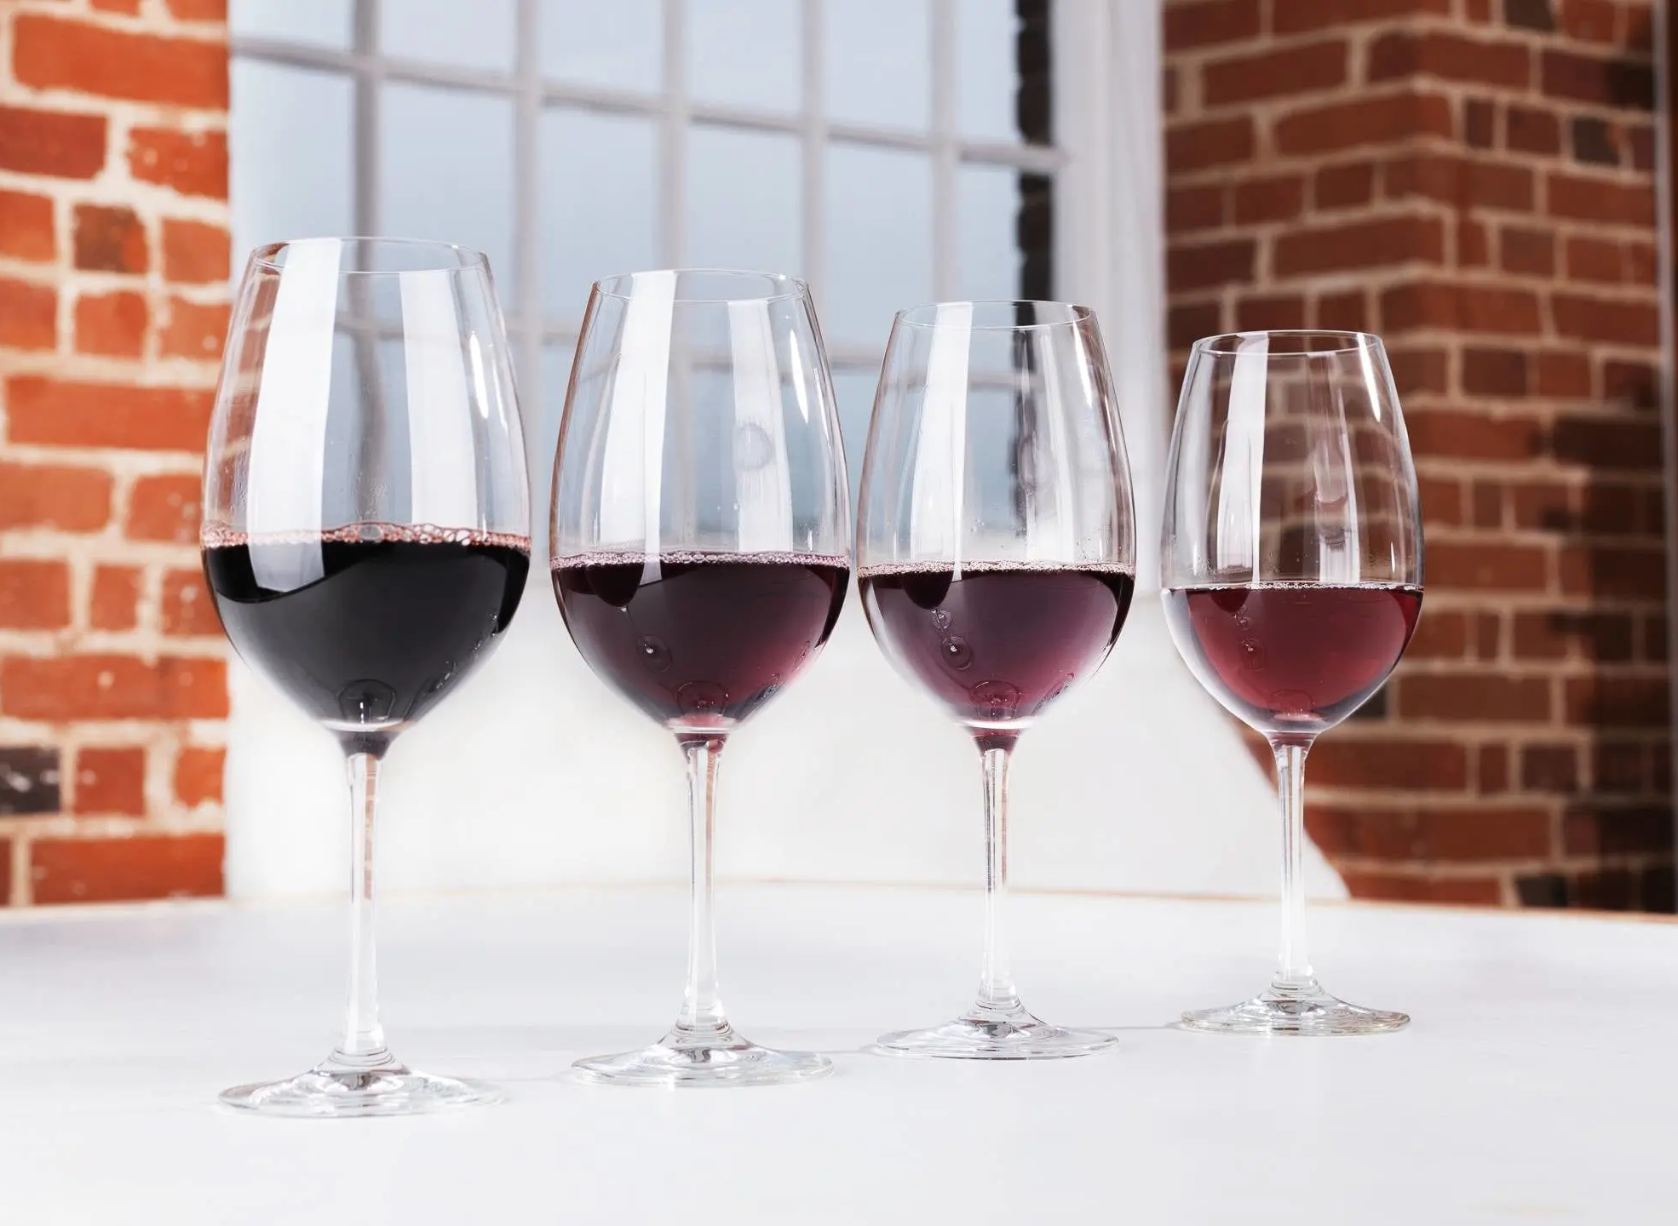
Agenda
In this presentation, we are going to explore -
Different red wine’s physicochemical characteristics.
Their impact on the wine quality.
A scientific way to rate the wine based on their physicochemical characteristics.
Notes:
Here we talk about horses and their whereabouts

Slide 3
Executive Summary
Alcohol quantity is the most important substance for the red wine quality.
Sulphates additive plays the second most important role in the wine quality .
Thirdly, increase in volatile acidity leads to decrease the wine quality.
Wine density is the fourth most important factor for the red wine quality.
Notes:
Here we talk about horses and their whereabouts

Slide 4
Alcohol percentage
Among all the elements, alcohol plays the most important role in wine quality (with correlation value 0.51).
Increase in alcohol (% vol.) quantity decreases the wine density.
Red wine with high percentage of alcohol is less salty.

Slide 5
Alcohol percentage
We should order a wine where the alcohol percentage is in between 11 to 13.
The best choice could be around 12 (% vol.) alcohol.
Notes:
Here we talk about horses and their whereabouts

Slide 6
Alcohol percentage
By the R-squared value, the regression model with alcohol and quality explains about 26% of the data.
Increase in alcohol percentage improves the wine quality.
Notes:
Here we talk about horses and their whereabouts

Slide 7
Sulphates additive
Sulphates has the second strongest correlation with red wine quality (with value 0.42).
We can say that the higher the amount of sulphates additive, the higher the wine quality.

Slide 8
Volatile acidity
Volatile acidity is the third most important factor for the wine quality.
Volatile acidity in wine (acetic acid) produces an unpleasant vinegar flavor.
There is a strong negative correlation between volatile acidity and wine quality (with value -0.35).

Slide 9
Volatile acidity
The increase of volatile acidity will decrease the wine quality.
By the R-squared value, the simple regression model with volatile acidity and quality explains about 12% of the data.

Slide 10
Density
Density is the fourth most important factor for the wine quality.
Increase in density will make the wine sweeter, but also more salty and more acidic.
High density wine is watery wine, with less alcohol.
Increase in density mildly decreases the wine quality.

Slide 11
Citric acid
In addition to the earlier mentioned elements, citric acid also plays a small role in wine quality.
Citric acid usually exits in wine in a very small amount.
Citric acid has a mild positive correlation with the wine quality with a value of 0.22.
Citric acid adds freshness and flavor to the wine.
Usually, the greater the amount of citric acid is greater the wine quality.

Slide 12
pH
By pH value, we measure how sour our wine is.
In red wine, pH scale value varies in decimal point.
pH factor has a very weak negative correlation with the wine quality with a value of -0.07.
Increase in pH value (in decimal point) will cause very little decreases in the wine quality.

Slide 13
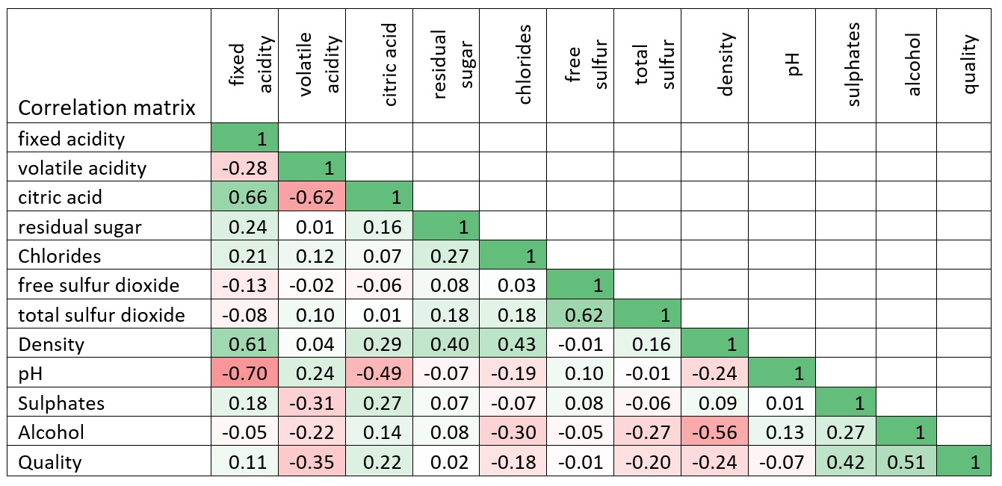
Overview of the correlation of different factors with quality

Slide 14
Design thinking & design principles
To make the presentation understandable for a less technical audience, I have used design thinking as flows :
This presentation is prepared in a simple way using Microsoft PowerPoint so that less or non-technical audiences can also understand the data and analysis results.
The presentation includes a visual representation of the findings so the audience can easily understand the results.
The presentation includes graphical charts that are common and not very complicated or technical. The used graphs, i.e., bar charts, are a common way of representing data and are commonly used in business presentations.
Finally, the findings are presented in a segmented manner by highlighting one element at a time.
Notes:
Here we talk about horses and their whereabouts

Slide 15
References:
UCI machine learning, Red Wine Quality, URL: https://www.kaggle.com/datasets/uciml/red-wine-quality-cortez-et-al-2009, Accessed: 04 October 2023
Image 1: https://sanmicheleorganic.com/the-grape-harvest-in-the-chianti-hills/, Accessed: 14 October 2023
Image 2: https://www.foodandwine.com/wine/smooth-wine, Accessed: 14 October 2023
Image 3: https://www.therealreview.com/2021/10/14/getting-wild-with-ferments/,Accessed: 14 October 2023
Image 4: https://no.wikipedia.org/wiki/Barrique,Accessed: 14 October 2023
Image 5: https://www.virginwines.co.uk/hub/wine-guide/wine-basics/types-of-red-wine/,Accessed: 14 October 2023

